Slide 1
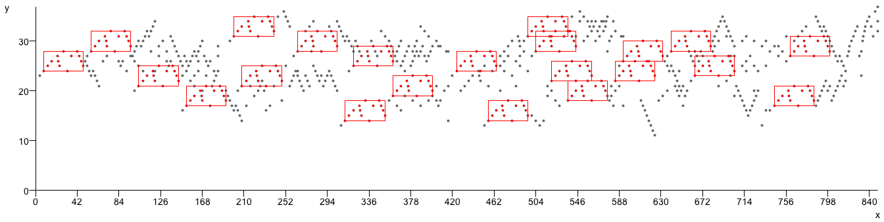

Compression-Based Geometric Pattern Discovery in Music
David Meredith
EuroMAC2014 Special Session on Computational Music Analysis
Leuven, 19-20 September, 2014

Slide 2

Repeated patterns in music
J.S. Bach, Fugue in C major, BWV 846
“the importance of parallelism [i.e., repetition] in musical structure cannot be overestimated. The more parallelism one can detect, the more internally coherent an analysis becomes, and the less independent information must be processed and retained in hearing or remembering a piece”
  Lerdahl and Jackendoff (1983, p.52)

Slide 3
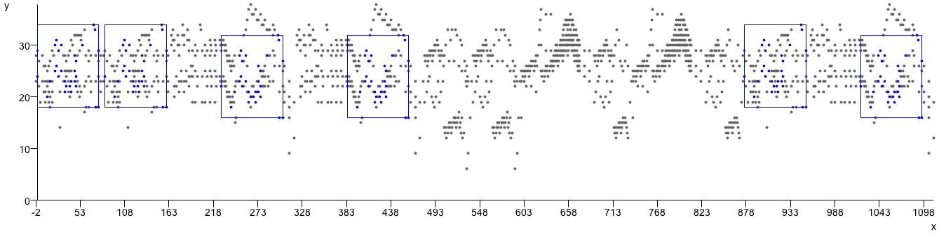
Repeated patterns in music
L. van Beethoven, Piano Sonata, Op.2, No.1, 3rd movement
“the central act” in all forms of music analysis is “the test for identity”
  Bent and Drabkin (1987, p.5)

Slide 4
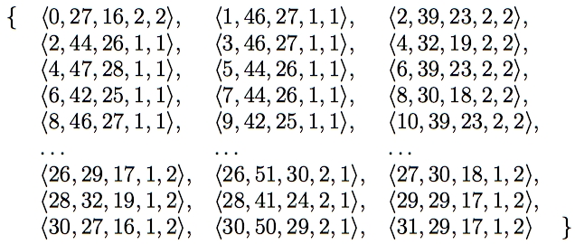
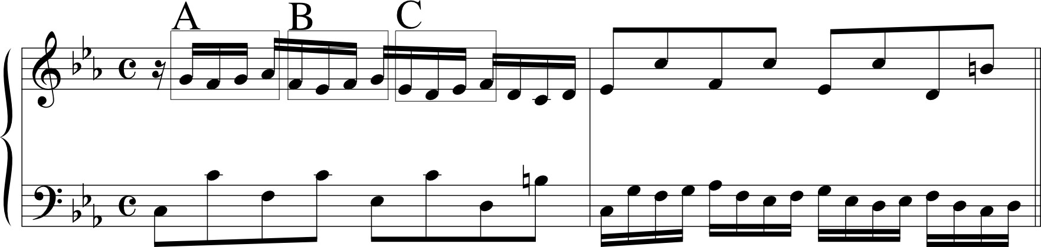

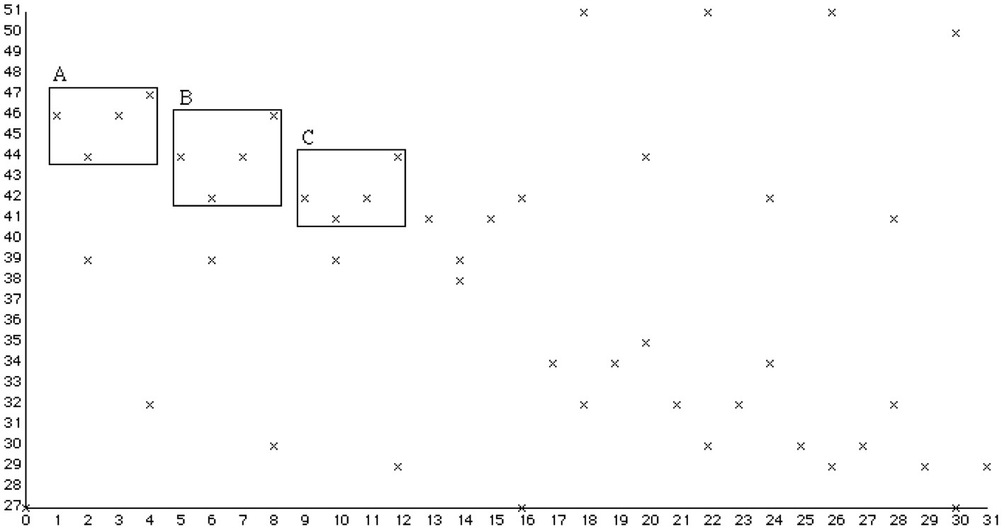
Using multidimensional point sets to represent music (1)
Notes:
I tried to avoid the problems I’ve just described by using multidimensional point sets instead of strings to represent the music and then developing algorithms to work on these point sets.
The algorithms developed work on point sets of any dimensionality.
There are many possible ways of representing a passage of music using a multidimensional point set but the way shown here has proved to be very useful.
Note that patterns A, B and C sound like versions of the same thing but have different representations in the chromatic-pitch-against time representation. Thus, to find these matches in this representation, you’d have to use an approximate matching algorithm.
However, the notation nicely represents the fact that these three patterns are heard as being versions of the same thing by representing each one as a falling step followed by two rising steps.
By using the diatonic pitch dimension and onset time, we can obtain such a representation.

Slide 5
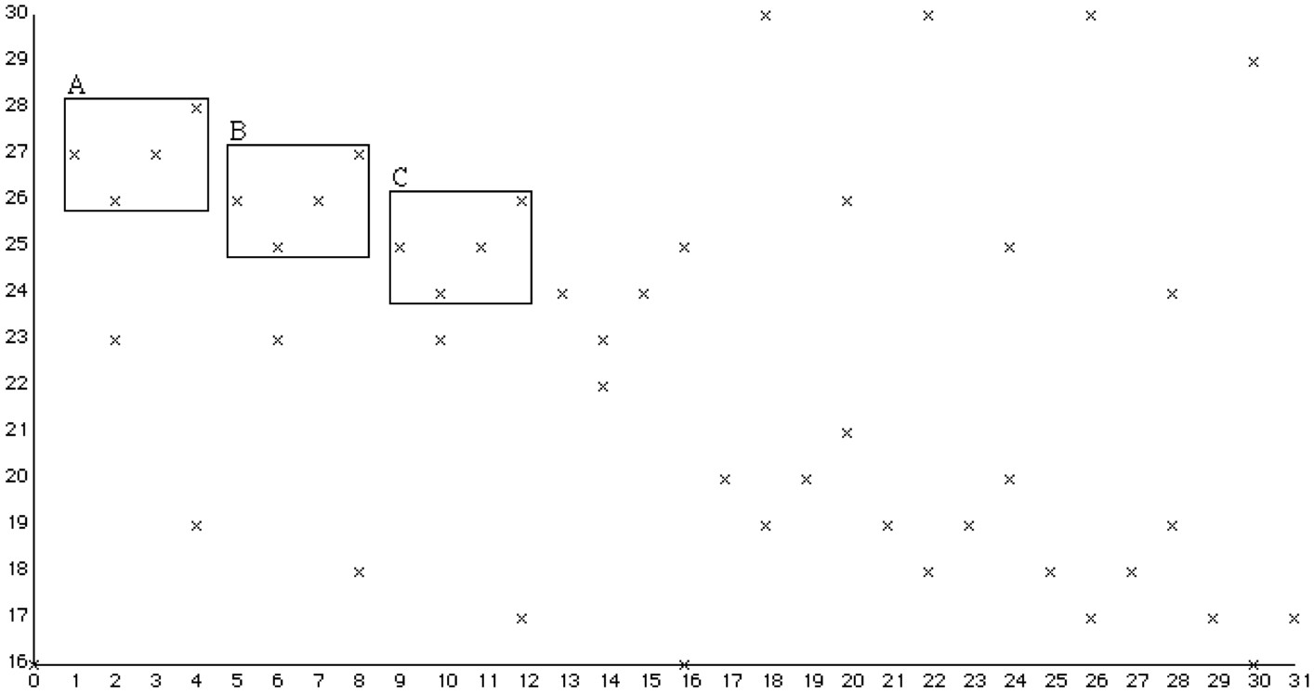
Using multidimensional point sets to represent music (2)
Notes:
However, when we’re trying to find interesting repeated patterns in tonal music, that is, music which has a key, it is often more fruitful to use a two dimensional projection which gives the diatonic pitch of the note and its onset time, as shown here.
Here, patterns A, B and C are exactly translationally equivalent and can thus be discovered using a fast exact matching algorithm.

Slide 6
Maximal translatable patterns (MTPs)

Slide 7
Translational equivalence classes (TECs)

Slide 8
Compression with TECs

Slide 9
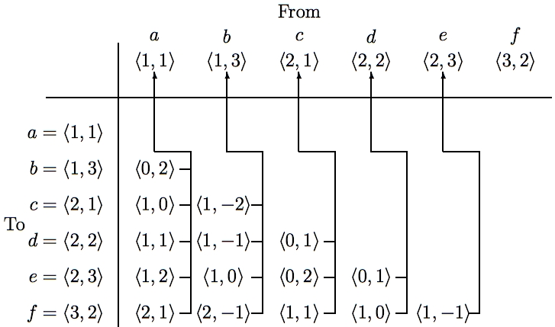
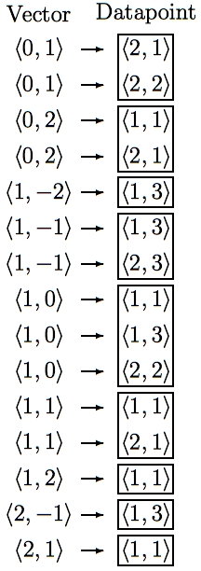
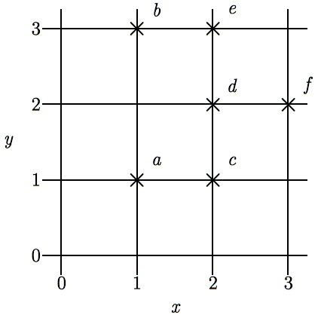
SIA - Discovering all maximal translatable patterns (MTPs)
Pattern is translatable by vector v in dataset if it can be translated by v to give another pattern in the dataset
MTP for a vector v contains all points mapped by v onto other points in the dataset
O(kn² log n) time, O(kn²) space
Notes:
The first algorithm I’m going to describe is the SIA algorithm which takes as input a multidimensional point set and discovers, for every vector, the points in this point set that are mapped onto other points in the point set by that vector.
For convenience, I’ll call the complete set of points being analyzed the DATASET and any subset of the dataset a PATTERN.
I say that a pattern is TRANSLATABLE by a particular vector within a dataset if it can be translated by that vector to give another pattern in the dataset. For example, the pattern {a,d} here is translatable within this dataset by the vector <1,0>.
And the pattern that contains ALL the points that are mapped onto other points in the dataset by a particular vector is the MAXIMAL TRANSLATABLE PATTERN for that vector. So the maximal translatable pattern or MTP in this dataset for the vector <1,0> is the pattern {a,b,d} and the MTP for the vector <1,1> in this dataset is {a,c}.
So SIA discovers all the non-empty maximal translatable patterns in a dataset.
It does this by first sorting the points in the dataset into lexicographical order and then computing the vector from each point to every other point in the dataset that is lexicographically greater. These vectors are stored in a table like this one here which we call a VECTOR TABLE. And each vector is stored with a pointer that points back to the origin point for which it was computed, as indicated by these arrows here.
The vectors in this table are then sorted into lexicographical order to give a list like the one here on the right and the MTP for each vector can be found directly by reading off the points attached to the adjacent occurrences of that vector in this list.
The most expensive step is sorting the vectors which can be done in O(kn^2 log n) time. However, by storing the origin points in a hash table and hashing the vectors to get the slot indices, this time complexity can be reduced to O(kn^2).
And also, obviously, the space used is O(kn^2)

Slide 10
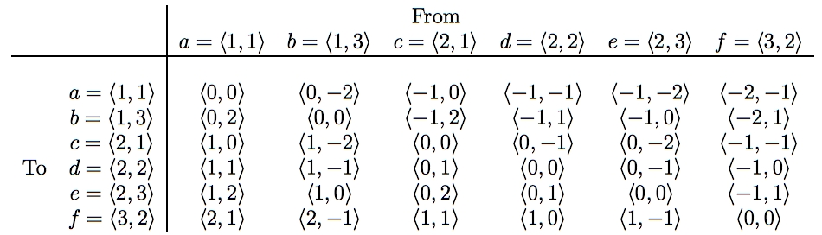
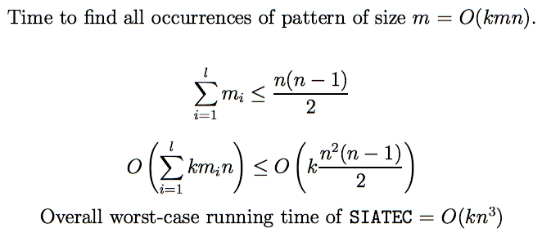
SIATEC - Discovering all occurrences of all MTPs
Translational Equivalence Class (TEC) is set of all translationally invariant occurrences of a pattern
Notes:
SIA only finds one occurrence of each MTP and one vector by which that MTP is translatable within the dataset.
SIATEC, on the other hand, finds all the MTPs using a slightly modified version of SIA and then finds all the vectors by which each MTP is translatable within the dataset.
In other words, it finds all the non-empty MTPs and then all the patterns within the dataset that are translationally equivalent to each MTP.
In SIA, we only needed to compute the vector from each point to every lexicographically greater point because the MTP for a particular vector -v is the same as the pattern that you get by translating the MTP for v by v itself.
However, in this simple implementation of SIATEC, we can find all the occurrences more efficiently by computing all the interpoint vectors and storing them in a table like this one here.
If the points in the dataset are sorted into lexicographical order first, then the vectors in this table increase lexicographically as you descend a column and go from right to left along a row.
Each column contains all the vectors by which the point at the top of the column is translatable within the dataset.
Therefore the set of vectors by which a given pattern in the dataset is translatable is equal to the intersection of the columns headed by the points in that pattern. For example, the pattern {a,c} is translatable within this dataset by the intersection of the columns for which a and c are the original points.
By exploiting the orderedness of this table, we can find all the occurrences of a k-dimensional pattern of size m in a dataset of size n in a worst case running time of O(kmn).
Now, all the MTPs in a dataset can be found by reading through the list of sorted vectors generated by SIA so we know that sum of the cardinalities of the MTPs is less than or equal to n(n-1)/2.
Therefore the worst case time complexity of this implementation of SIATEC is [as shown] which implies that it is O(kn^3).
And, obviously, it uses O(kn^2) space.

Slide 11
Need for heuristics to isolate interesting MTPs
2^{n} patterns in a dataset of size n
SIA generates < n²/2 patterns
  sum of cardinalities of MTPs is n(n-1)/2
  => SIA generates small fraction of all patterns in a dataset
Many interesting patterns derivable from MTPs found by SIA
  e.g., bounding box or segment spanned by the patterns
BUT many of the patterns found by SIA are NOT interesting
    70,000 patterns found by SIA in Rachmaninoff’s Prelude in C# minor
    probably about 10-20 are interesting
=> Need heuristics for isolating interesting patterns in output of SIA and SIATEC

Slide 12
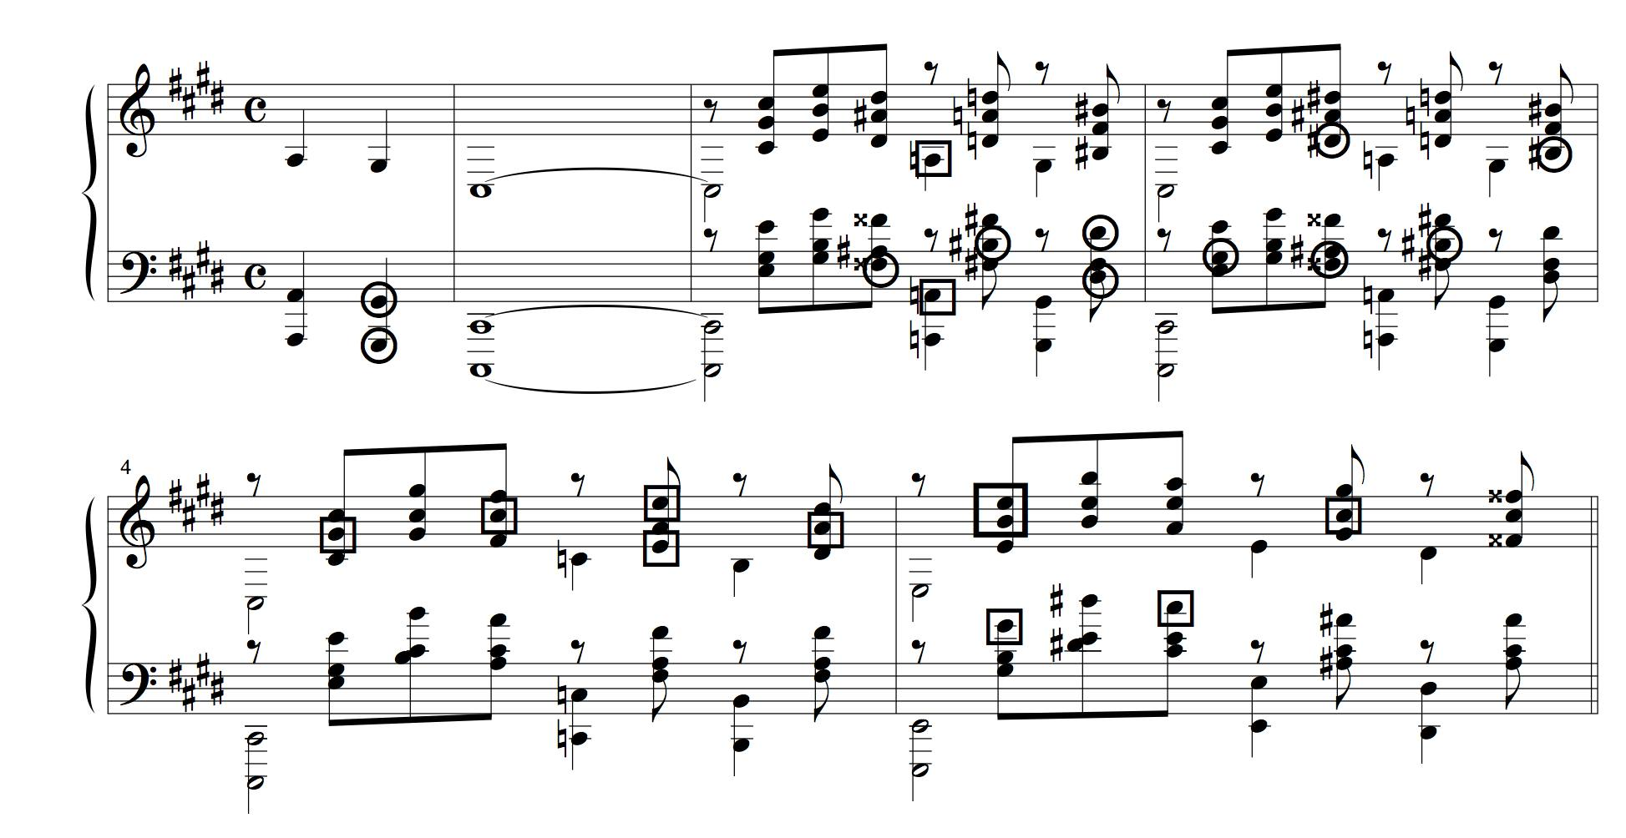
Most musical repetitions are neither perceived nor intended
S. Rachmaninoff, Prelude in C sharp minor, Op.3, No.2
Notes:
Although identifying the important repetitions in a passage of music is an essential part of understanding it, most of the pattern repetitions that occur in music are neither perceived nor intended by the composer.
For example, here we have the first few bars of Rachmaninoff’s Prelude in C sharp minor, Op.3, No.2.
The pattern consisting of the notes in elliptical boxes is repeated 7 crotchets later, transposed up a minor ninth to give the pattern consisting of the notes in square boxes.

Slide 13
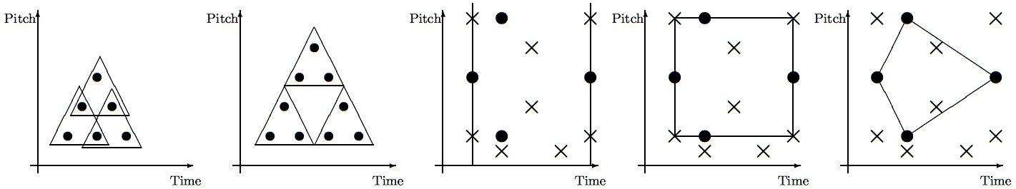
Heuristics for isolating the “best” patterns
Cov=6 CR=6/5 | Cov=9 CR=9/5 | Comp = 1/3 | Comp = 2/5 | Comp = 2/3
Notes:
We found we could go some way towards isolating the themes and motives in a piece of music by using just three simple heuristics which I will now describe.
First, let’s define the coverage of a pattern to be the number of distinct points in the dataset in occurrences of the pattern. For example, the coverage of this triangular pattern in this dataset is 6, but in this dataset, its coverage is 9.
In general, the coverage of a pattern is greater for larger, non-overlapping patterns that occur frequently.
if we represent a passage of music as a set of points in graph of pitch against time, musical themes generally seem to have relatively high coverage.
Next, let’s define the compactness of a pattern to be the ratio of the number of points in a pattern to the number of points in the region spanned by the pattern.
The region spanned by a pattern can be defined in various ways.
For example, we can define the region spanned by a pattern in a pitch-time representation of a passage of music to be the segment containing all the notes that start between the first and last note onsets in the pattern.
Alternatively, we could define the region spanned by a pattern in such a representation to be the bounding box or convex hull of the pattern.
As you can see here, the compactness value obviously depends on how the region spanned by a pattern is defined.
However, musical themes typically have at least one occurrence with relatively high compactness since this will make the pattern easier to perceive. However, other occurrences may be highly embellished and thus have lower compactness.
Another interesting heuristic that seems to be useful for isolating themes is the compression ratio that can be achieved by representing the set of points covered by all the occurrences of a pattern by specifying just one occurrence of the pattern together with all the vectors by which the pattern is translatable within the dataset.
For example, by doing this with the triangular pattern in this dataset, we achieve a compression ratio of 6/5. However, in this dataset, the same pattern can be used to achieve a compression ratio of 9/5.

Slide 14
COSIATEC
Start
Dataset
SIATEC
List of <Pattern, Translator_set> pairs
Add best TEC, <P,V> to encoding
Remove points covered by <P,V> from dataset
Is dataset empty?
No
Yes
Output encoding
Notes:
We can use SIATEC together with the heuristics I’ve just described to construct a simple compression algorithm which I call COSIATEC. COSIATEC works like this.
First we use SIATEC to generate a list of <Pattern, Translator_set> pairs in which each pattern is an MTP and each translator set contains all the non-zero vectors by which the pattern is translatable within the dataset. This generally gives a more efficient representation of the set of points covered by the occurrences of a pattern.
Then we can use the heuristics I’ve just described - compression ratio, coverage and compactness - to choose the “best” pattern P and this pattern is printed out together with its translator set.
Then all the points covered by P and its occurrences are removed from the dataset.
Then if the dataset is empty, we end; otherwise, we again run SIATEC on the remaining points in the dataset.
The result is a print out of the “best” pattern and its translators for each iteration of the cycle and this printout is usually a compressed representation of the input dataset.
Obviously, the degree of compression achieved depends on the amount of repetition in the dataset.

Slide 15
Forth’s algorithm
(Forth 2012, Forth and Wiggins 2009)

Slide 16
SIACT and SIAR
(Collins et al. 2010, Collins 2011)

Slide 17
SIATECCompress
Adds a TEC to encoding if its <P,Θ> representation is shorter than the set of new points covered

Slide 18
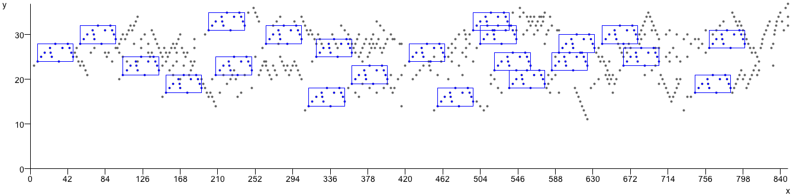
J.S. Bach, Fugue in C major, BWV 846
Fugue in C major, BWV 846
  Input length: 729 points
  Encoding length: 249 points or vectors
  26 TECs used to account for piece
  24 notes (3.29%) not included in repeated patterns
  Compression ratio: 2.93

Slide 19
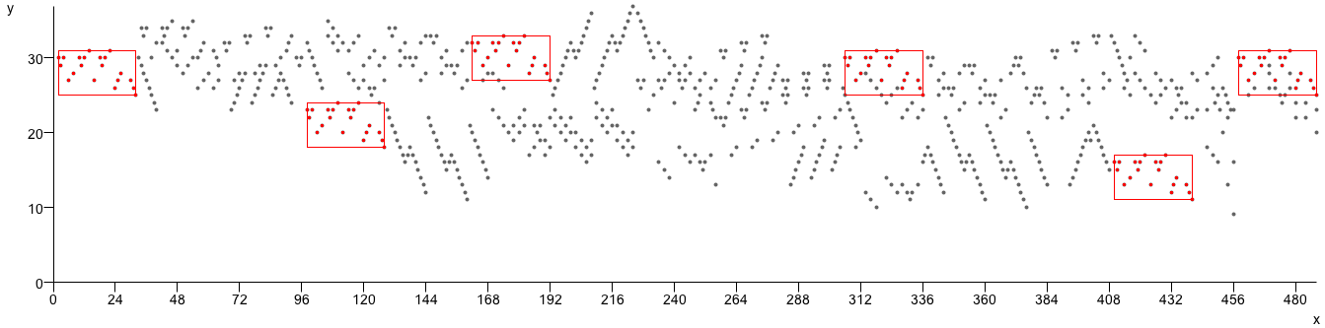
J. S. Bach, Fugue in C minor, BWV 847
Fugue in C minor, BWV 847
  Input length: 751 points (notes)
  Encoding length: 273 points or vectors
  25 TECs (patterns) used to account for piece
  22 notes (2.66%) not included in a repeated pattern
  Compression ratio: 2.75

Slide 20
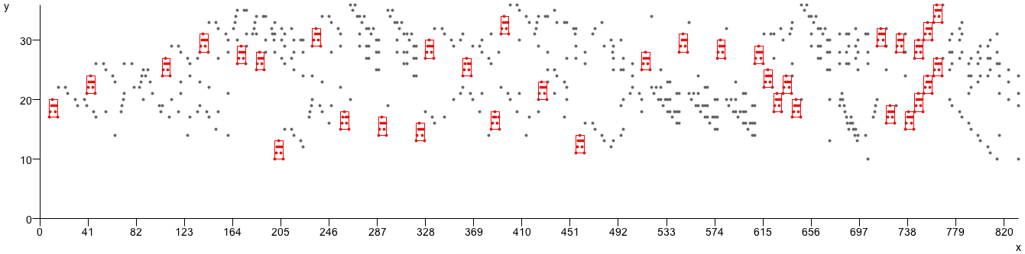
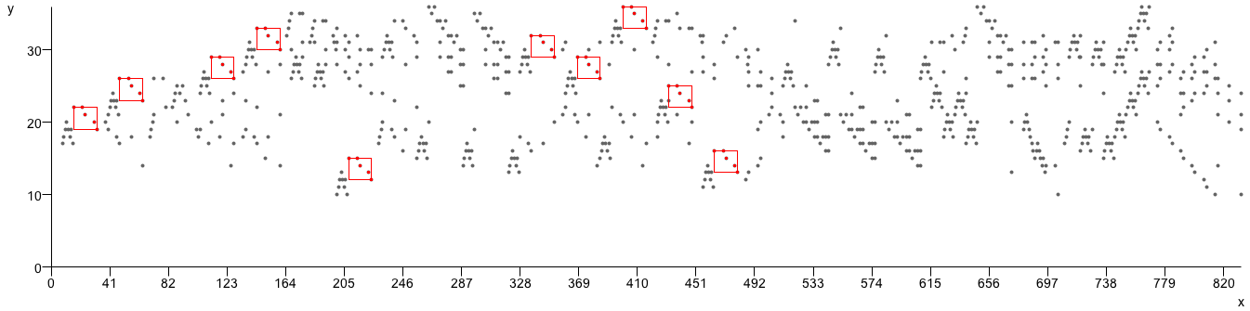
J.S. Bach, Fugue in D major, BWV 850
Fugue in D major, BWV 850
  Input length: 772 points
  Encoding length: 260 points or vectors
  28 TECs used to account for the piece
  Compression ratio: 2.97
  26 notes (3.37%) not included in repeated patterns

Slide 21
Example COSIATEC encoding of NLB folk song
(NLB015569_01, “Daar zou er een maagdje vroeg opstaan 2”, from the Nederlandse Liederen Bank, http://www.liederenbank.nl. Courtesy of Peter van Kranenburg.)

Slide 22
Results of using algorithms with NCD and 1-nn to classify NLB

Slide 23
Discovering repeated themes and sections in the JKU PDD
Five pieces in database – polyphonic version used!
Three basic algorithms, COSIATEC, SIATECCompress and Forth’s algorithm
  with and without CT
  SIA or SIAR
  Raw, BB or Segment mode
Gives 36 algorithms formed by combining values from these 4 variables

Slide 24
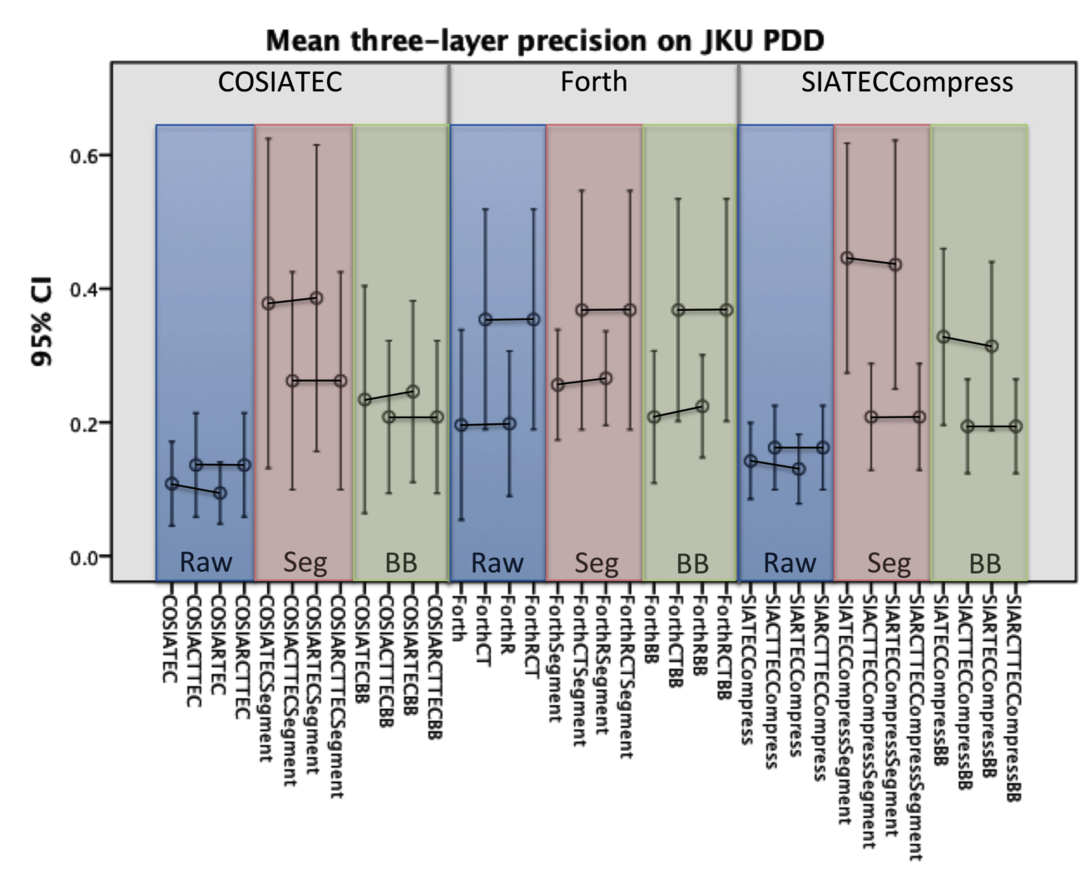

Slide 25
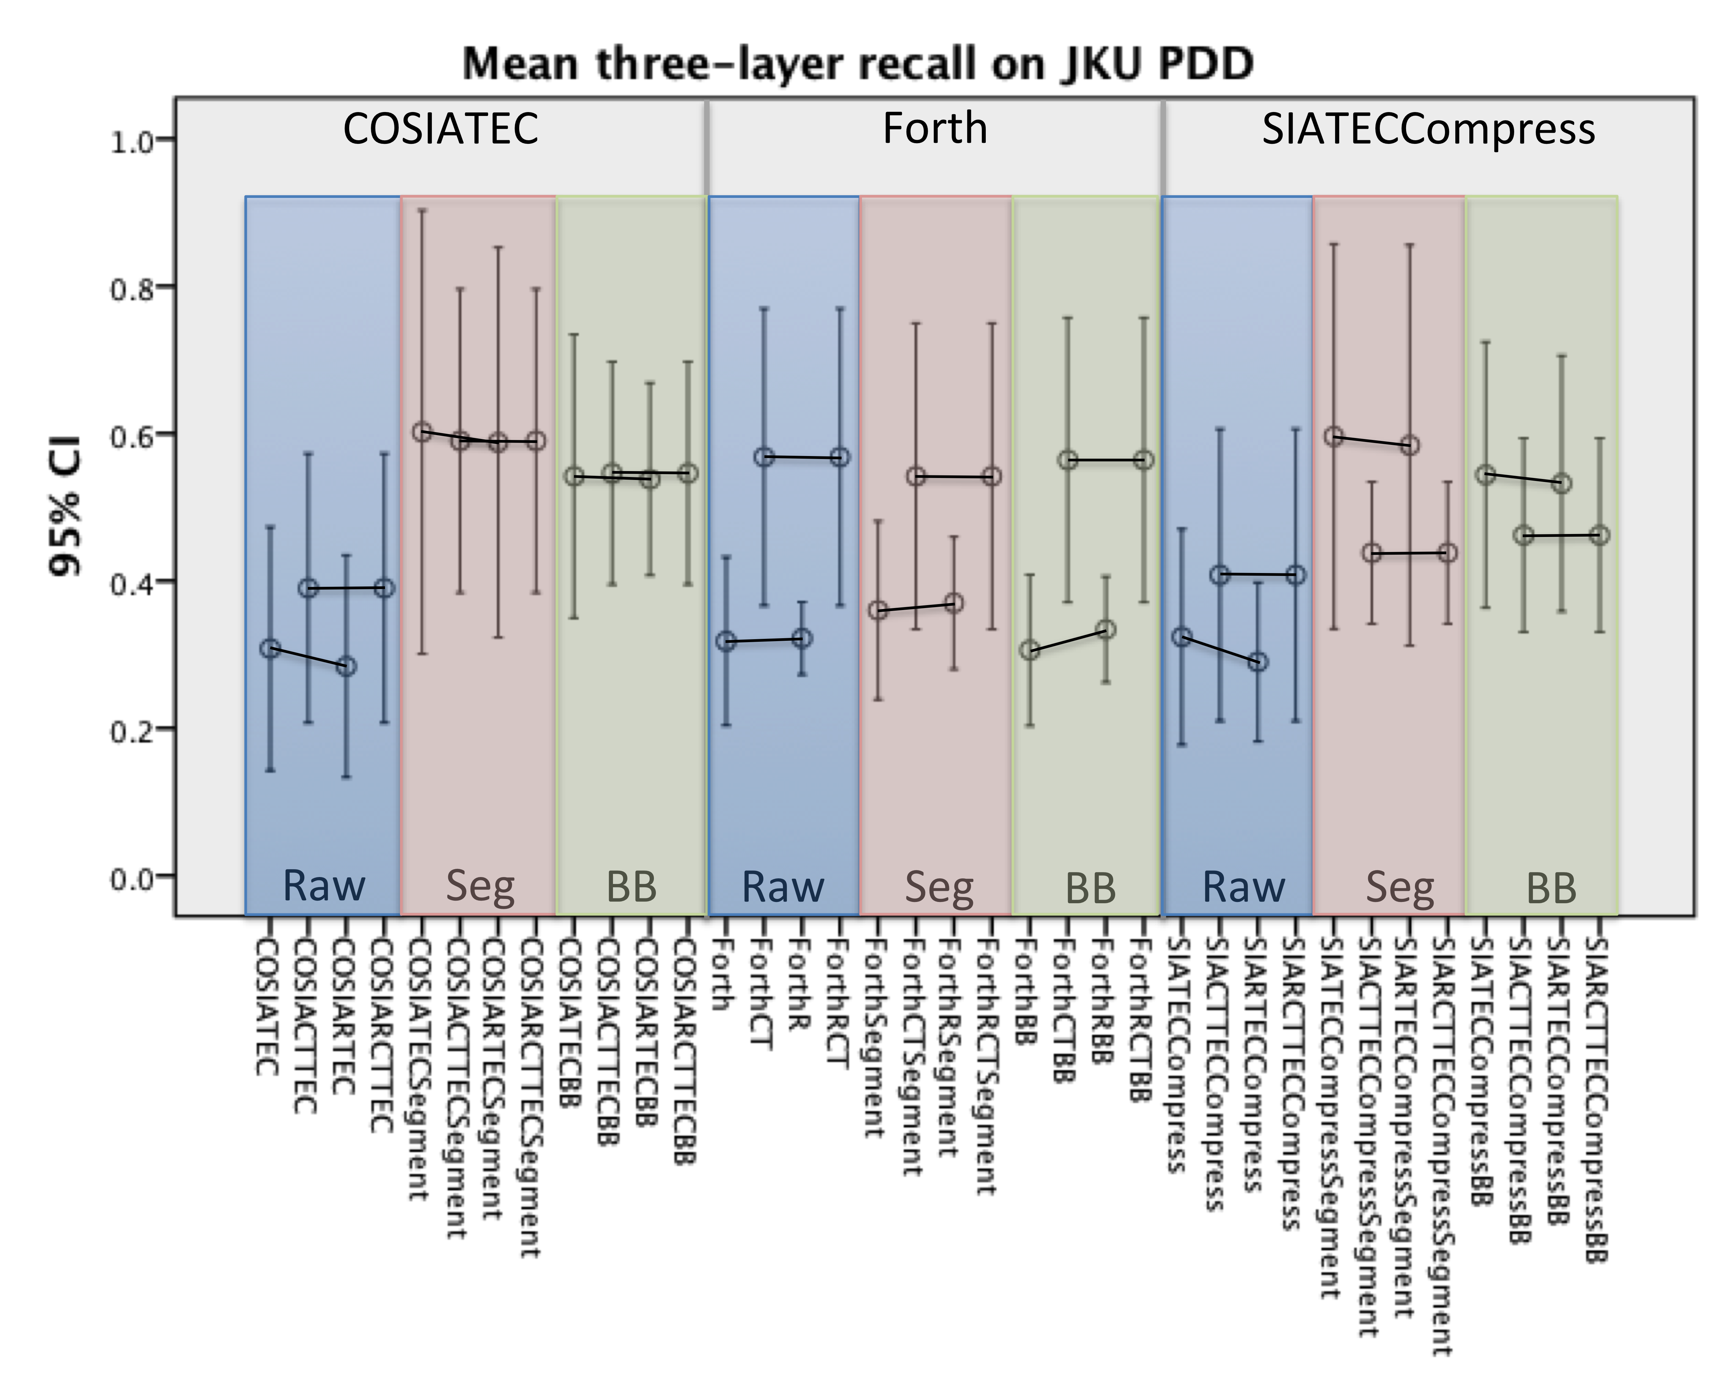

Slide 26
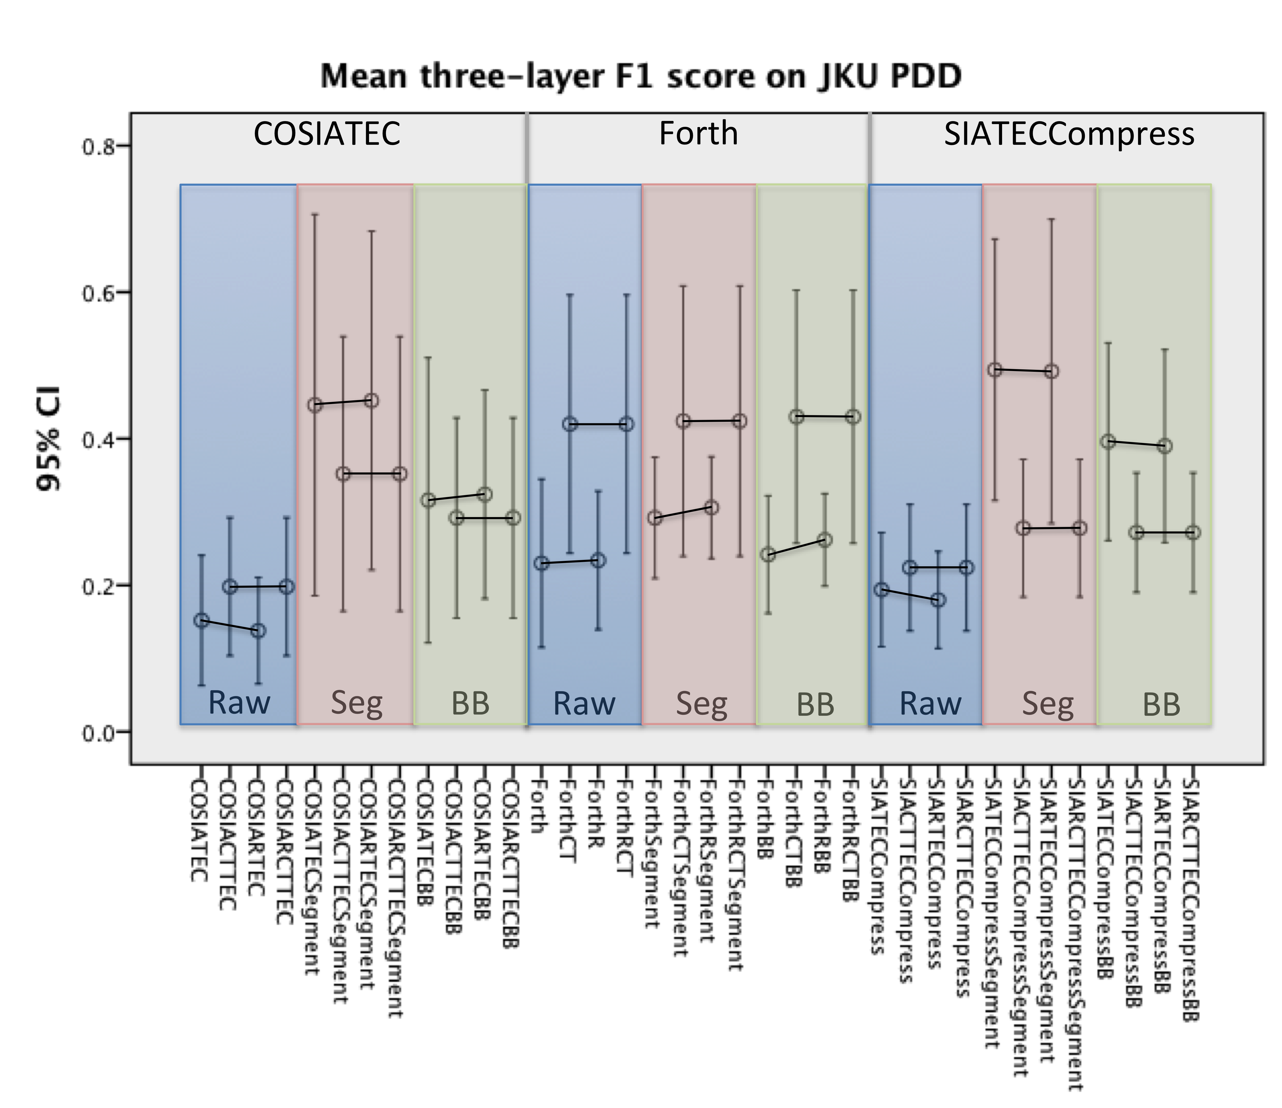

Slide 27
JKU results
Above are three-layer F1 scores for best and basic algorithms
Replacing SIA with SIAR had no significant result on precision, recall or F1
CT had a positive effect with Forth’s algorithm but generally a negative effect on COSIATEC or SIATECCompress (except in Raw mode)
Top-performing algorithms used Segment mode

Slide 28
Evaluation of JKU PDD
To what question is the JKU PDD supposed to be providing the correct answer?
  “What are the noticeable and/or important patterns in these five pieces?”
Do the analyses in the JKU PDD actually identify all and only the noticeable and/or important patterns in the pieces in the database?
  No!
    some important patterns are missing
    some important occurrences of recorded patterns are missing

Slide 29
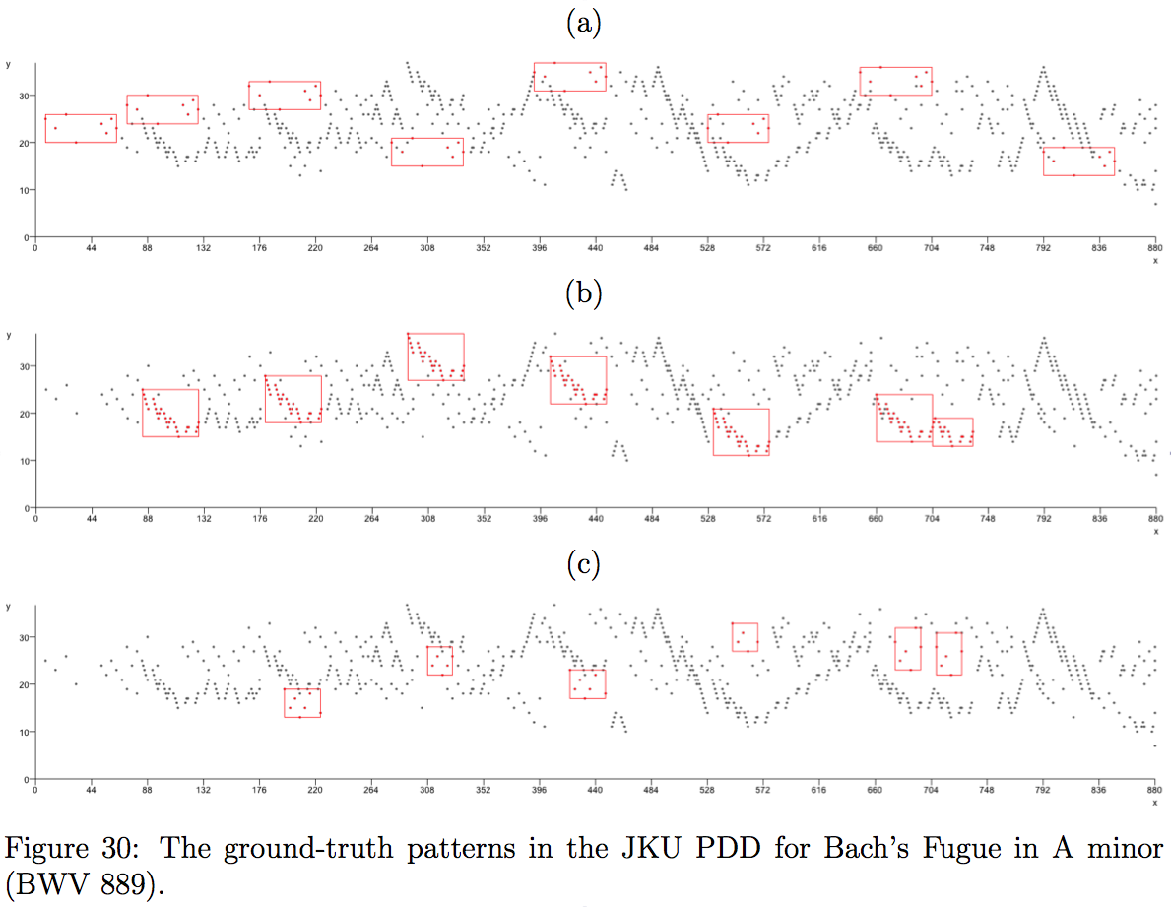

Slide 30
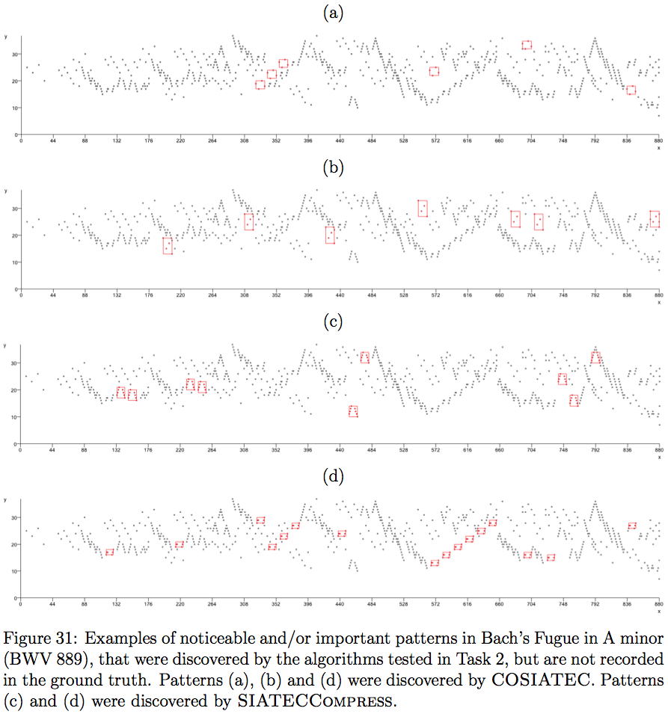

Slide 31
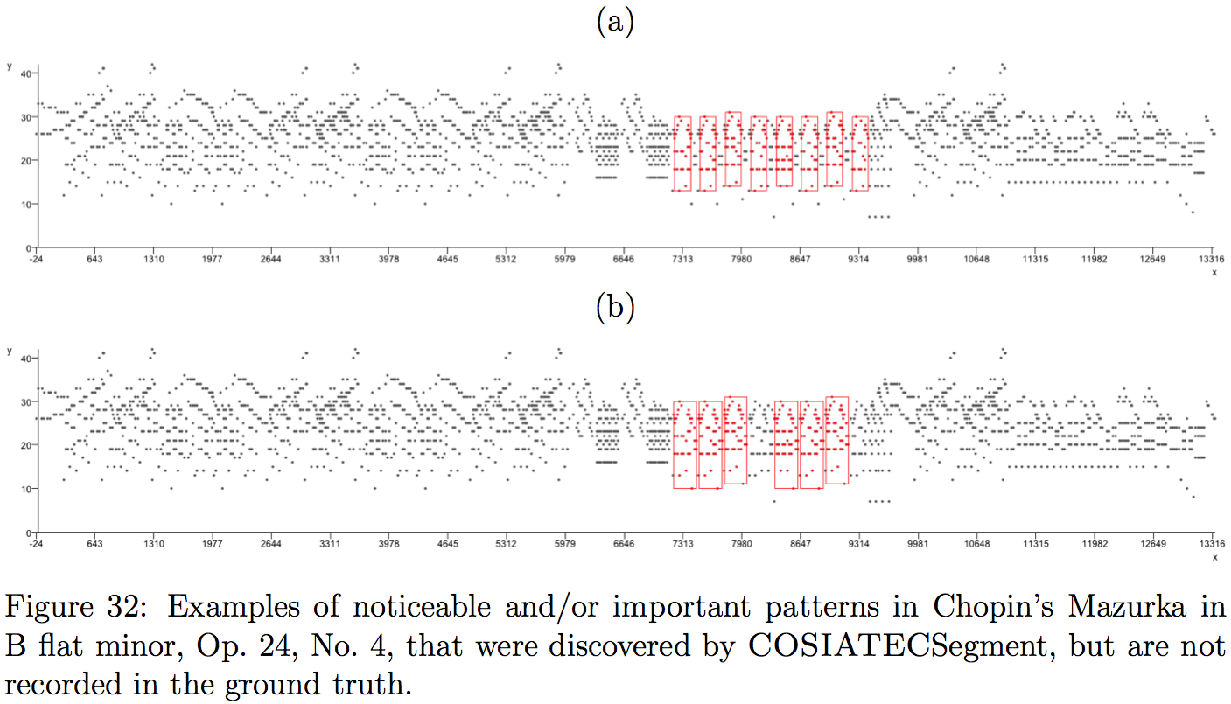

Slide 32
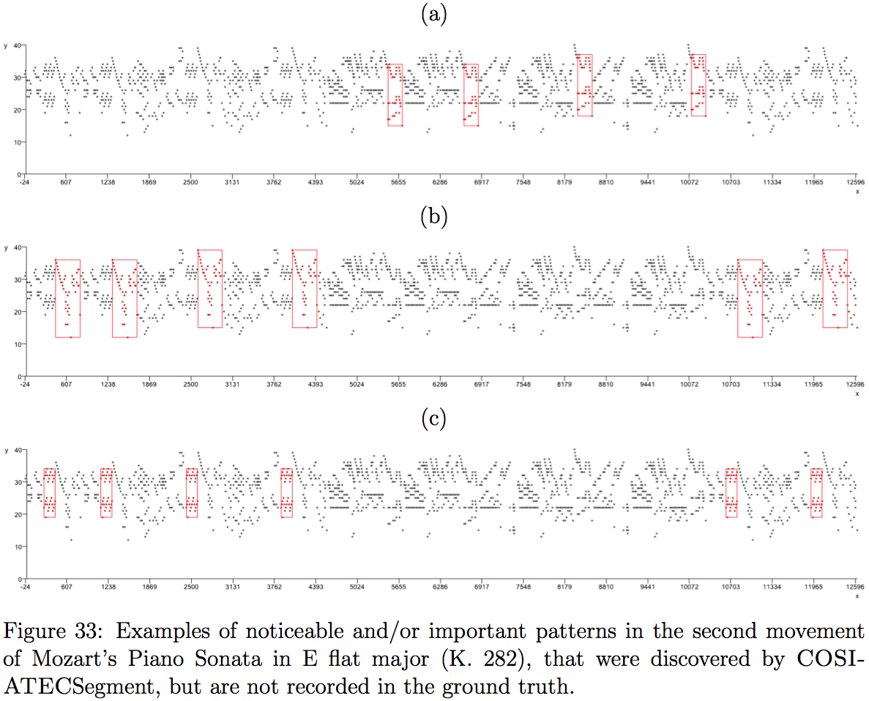

Slide 33
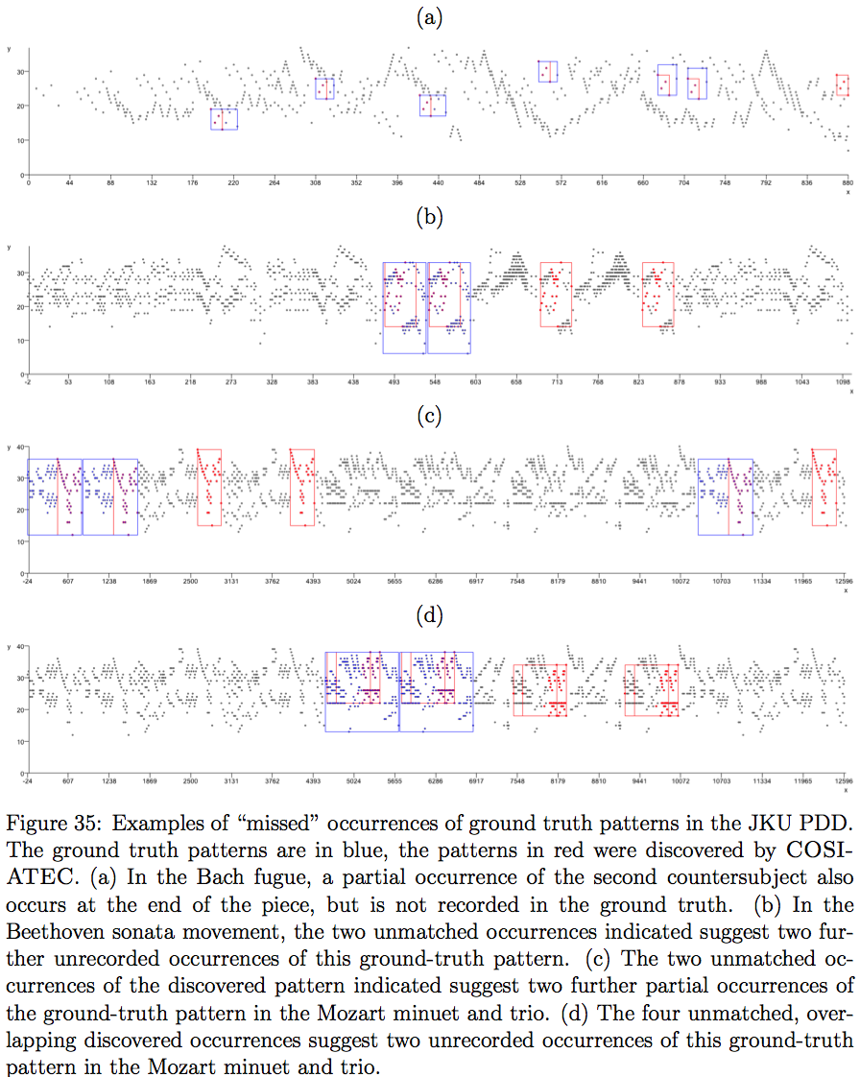

Slide 34
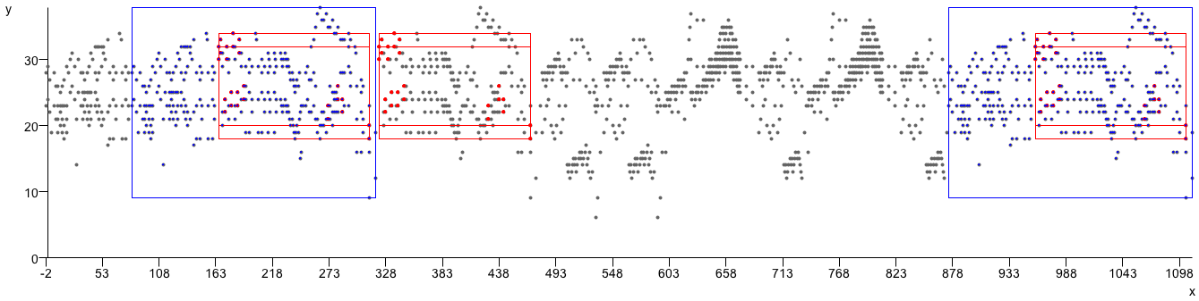
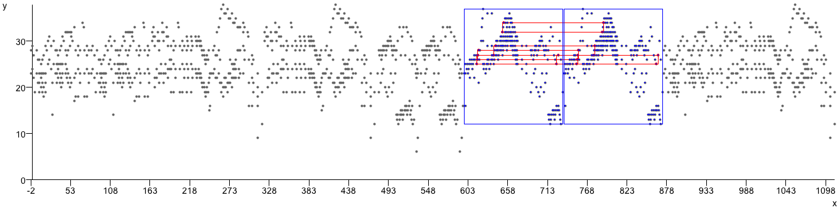
Example outputs
Blue = ground-truth, Red = COSIATEC

Slide 35
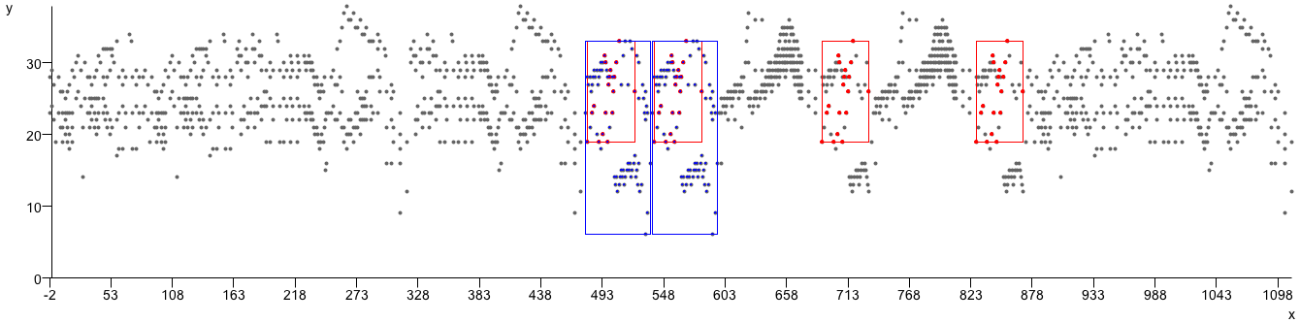
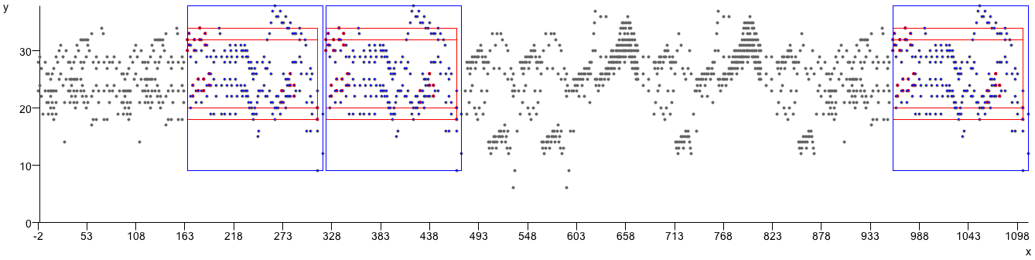
Example outputs
Blue = ground-truth, Red = COSIATEC

Slide 36
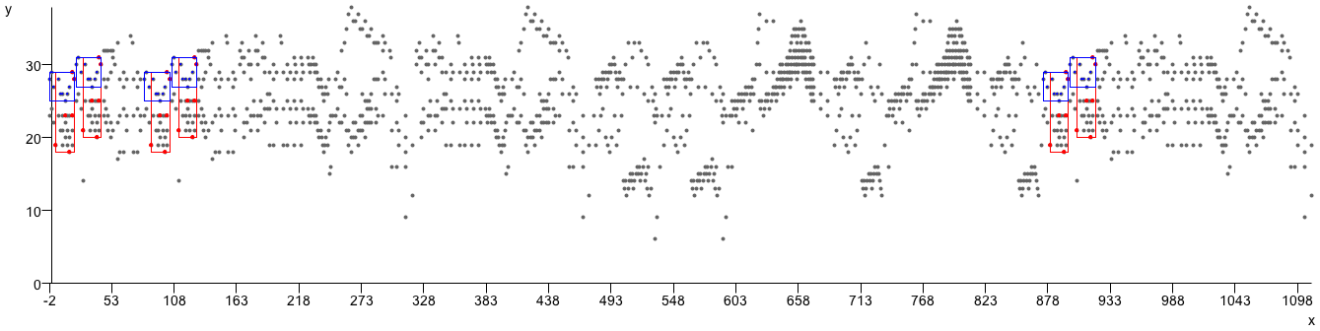
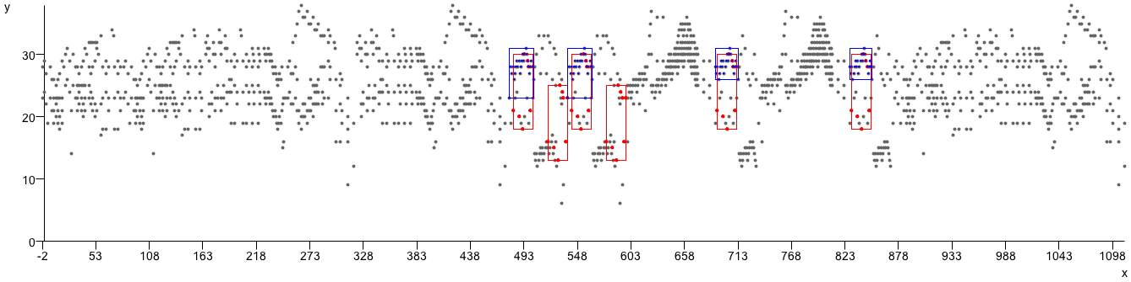
Example outputs
Blue = ground-truth, Red = COSIATEC

Slide 37
Acknowledgements
The research reported in this talk was carried out as part of the “Learning to Create” FP7 collaborative project.
The project Lrn2Cre8 acknowledges the financial support of the Future and Emerging Technologies (FET) programme within the Seventh Framework Programme for Research of the European Comission, under FET grant number 610859.

